Slide 1
Illuminatin Source Calculations

Slide 2
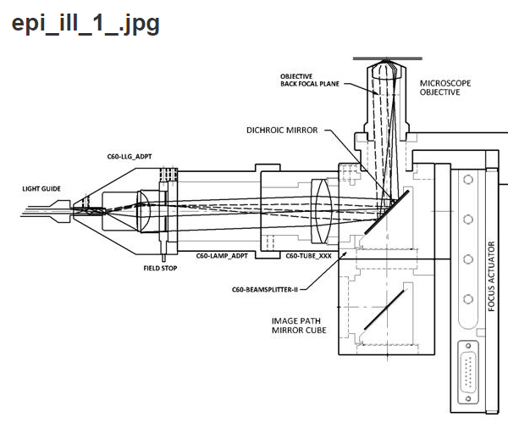
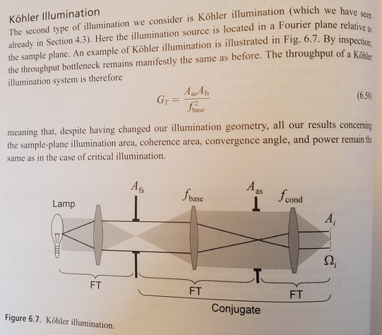
Generalized Kohler Illumination and ASI specific Setup
Note Aperture Stop is at objective back focal plane and is pupil size in ASI construction
Pupil size is 20mm for Nikon 16x 0.8NA water dipper

Slide 3
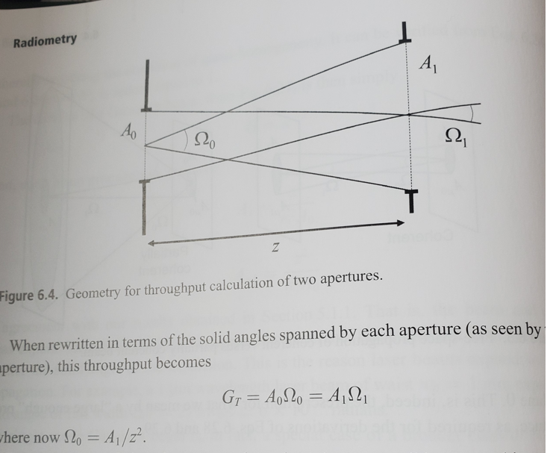
Illumination Source sufficient for System?
Look at throughput of system and etendue of illumination source. Need throughput of system to exceed etendue of illumination source

Slide 4
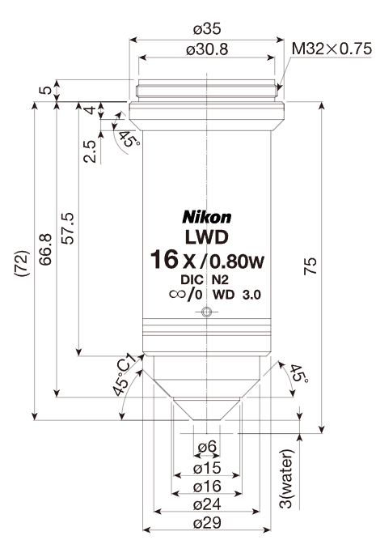
Calculation
LED from ASI is LXM2-PD01-0050
According to Luxeon, its 1mm^2 for area
125 degrees is angle at which intensity is at 50%

